Slide 1
Indian Sign Language Recognition Using Deep Learning
Personal Chatbot for Stock Portfolio Management with Agentic AI Framework
Name: KANDULA JITHENDRA SUBRAMANYAM
Roll No.: 16034424030
Guide:prof SUNAYANA JADHAV
Name: Nirmit Shah
Roll No.: 16034424025
Guide: Ms. Sujata Pathak

Slide 2
Table of Content
Introduction
Motivation
Problem Definition
Objective
Literature Review
Scope
Novelty
Data Sources
Data Description
Conclusion
Future Work

Slide 3
Introduction
The Living Market: A stock portfolio is not a static collection of assets; it is a highly volatile, living ecosystem driven by global events, algorithmic trading, and sudden shifts in human psychology.
The Illusion of Isolation: No stock operates in a vacuum. Hidden structural webs—such as shared institutional ownership—mean a ripple in one sector can instantly become a tidal wave in another.
The Navigation Paradox: To survive this complex environment, investors need dynamic, forward-looking intelligence. Yet, everyday users are equipped only with flat, historical dashboards that act like a rearview mirror during a storm.
Notes:
Before we talk about AI, we need to completely reframe how we look at the stock market. We are often taught to view a stock portfolio as a static collection of assets—a spreadsheet of numbers. But the reality is much more chaotic. The market is a highly volatile, living ecosystem.
When an everyday investor buys a tech stock and a healthcare stock, they believe they are diversified. They believe their assets are isolated. But as my research into contagion has shown, this is an illusion. Because massive institutions hold all of these stocks simultaneously, a sudden shock in one sector travels through these hidden webs and crashes the others. A ripple becomes a tidal wave.
This is the 'Navigation Paradox.' The market is a multi-dimensional, deeply interconnected storm. But what tools do we give the average investor to survive it? Flat, static dashboards that only show them what happened yesterday. It is like giving someone a rearview mirror to navigate a hurricane. That is the exact reality my chatbot framework is designed to change.

Slide 4
Motivation
The Regulatory & Transparency Barrier: While multi-agent AI offers immense power for institutional risk management, its "black box" nature fails strict compliance standards (e.g., MiFID II, GDPR) and prevents user trust.
The Accessibility Gap: Advanced portfolio governance—such as regime-switching and contagion detection—remains highly technical and entirely inaccessible to the everyday retail investor.
The Core Objective: The motivation of this thesis is to bridge this gap by taking a mathematically rigorous, institutional-grade risk framework and translating it into a transparent, conversational, and fully auditable financial assistant.
Notes:
We know that multi-agent AI can manage risk and detect market instability. But having a powerful engine isn't enough. In the financial sector, trust and compliance are everything. Because most AI operates as an unexplainable 'black box,' it fails regulatory audits like MiFID II and GDPR, and users simply cannot trust it with their savings.
Furthermore, there is a massive accessibility gap. The advanced portfolio governance tools that institutions use to survive market crashes are incredibly technical. The everyday investor has no way to access or understand them.
My motivation is to democratize this technology. I want to take the complex, deterministic risk frameworks I developed in my previous research and pair them with a conversational AI. The goal is to build a system that doesn't just do the complex math behind the scenes, but can actually sit down with the user, explain its reasoning in plain English, and provide safe, auditable financial guidance.

Slide 5
Problem Definition
Algorithmic Brittleness: Traditional portfolio optimizers act as "error-maximizers" during market shocks, failing to adapt to rapid covariance drift and systemic contagion.
The Compliance Deficit: While probabilistic AI models can detect market shifts, they operate as un-auditable "black boxes." They require undocumented human judgment to execute trades, directly violating transparency regulations like MiFID II and GDPR Article 22.
The UX & Retail Disconnect: Institutional-grade downside protection is entirely disconnected from the end-user. Retail investors are restricted to static dashboards that cannot offer real-time, conversational guidance or explain their risk exposure.
The Core Problem Statement: How can we engineer an AI system that delivers mathematically rigorous, crisis-resistant portfolio governance while remaining structurally isolated, fully auditable, and conversationally transparent?
Notes:
algorithmic brittleness. Traditional optimization models fail spectacularly during market crashes. When volatility spikes and covariance drifts, these models amplify errors rather than protect the portfolio.
next compliance deficit. We have advanced AI that can predict these crashes, but we cannot legally use most of it. Probabilistic models are 'black boxes.' They require undocumented human guesswork to turn a probability into a portfolio weight, which completely fails strict regulatory standards like MiFID II and GDPR.
Third is the user disconnect. Even if we fix the math and the compliance, the everyday investor still can't use it. They are stuck staring at static dashboards.
Therefore, the exact problem this work solves is this: How do we build a system that provides institutional-grade downside protection, guarantees 100% regulatory auditability, and can actually speak to the user to explain its decisions?"

Slide 6

Objectives:
Architect a Data-Driven Multi-Agent Engine: Integrate real-time data into a deterministic multi-agent framework designed to seamlessly handle portfolio diagnostics, risk assessment, forecasting, and optimization.
Integrate Dynamic Governance & Human Oversight: Deploy adaptive instability detection and incorporate a structured Human-in-the-Loop (HITL) mechanism to safely validate all AI-generated allocation decisions before execution.
Ensure Conversational Auditability: Engineer a structurally isolated LLM to generate grounded, conversational explanations for each portfolio decision, translating complex math into auditable narratives.
Comprehensive Empirical Validation: Evaluate both the portfolio's financial performance (e.g., drawdown reduction) and the AI's explanation reliability using standard metrics to prove system resilience and trustworthiness.
07-03-25
6
Notes:
First, we need to architect the engine itself. We will integrate real-time market data into a deterministic, multi-agent framework. Instead of one AI trying to do everything, we will have specialized agents handling risk assessment, forecasting, and optimization.
Second, we are integrating dynamic risk governance with strict human oversight. Using the instability models from my prior research, the system will actively protect the portfolio, but we are adding a Human-in-the-Loop mechanism. This ensures that a human validates the AI's rebalancing decisions before any capital is moved.
Third, we must ensure conversational auditability. We will use a structurally isolated language model to generate grounded, conversational explanations for every single allocation decision. It won't just say 'rebalance'; it will explain exactly why based on the math, keeping us fully compliant with regulations.
Finally, we will empirically validate the entire system. We won't just measure standard financial metrics like maximum drawdown; we will also rigorously evaluate the reliability and accuracy of the AI's generated explanations to ensure the system is genuinely trustworthy."

Slide 7
Literature survey
Year | Title | Approach / Methodology | Key Contribution | Limitation / Gap
2024 | Limitations of LLMs in Financial Forecasting | Conducted large-scale testing of LLM predictions vs actual stock movements using historical price datasets | Demonstrates that LLMs frequently hallucinate numerical facts and fail to generate reliable forecasts | Does not explore the impact of structured agents, tool-use, or planner-guided reasoning to reduce errors
2025 | The Unreliability of AI Chatbots in High-Stakes Decision-Making | Ran behavioral experiments where users made investment decisions based on chatbot responses | Shows financial chatbots produce inconsistent advice and amplify user risk due to misleading explanations | Evaluates only generic chatbots, not specialized agentic systems designed for controlled financial analysis
2024 | Hallucinations in Financial LLMs: A Quantitative Study | Benchmarked multiple LLMs on financial QA datasets and measured hallucination levels during market volatility | Provides strong evidence that LLMs hallucinate more in finance than in other domains | Lacks mechanisms for controlling hallucinations such as retrieval, modular agents, or fact-verification tools

Slide 8
Literature survey
Year | Title | Approach / Methodology | Key Contribution | Limitation / Gap
2023 | Retrieval-Augmented Multi-Agent System for Financial Sentiment Analysis | Retrieval-Augmented Generation (RAG) + multi-agent pipeline (retriever, analyzer, aggregator). | Improves sentiment reliability; reduces hallucination through retrieval grounding. | Dependent on retrieval quality; no integration with portfolio optimization; lacks uncertainty scoring.
2024 | Agentbase: A Framework for Handling Multiple Agents | Framework for state-sharing, role delegation, and multi-agent tool-use. | Modular and scalable MAS framework; improves construction of agent systems. | No correctness guarantees; not evaluated in finance; lacks uncertainty and safety mechanisms.
2024 | Overfitting & Instability in Algorithmic Advisors | Analyzed machine learning–based robo-advisors on multiple datasets to detect overfitting patterns | Shows automated portfolio models become unstable during market shocks and underperform simple strategies | Study targets pure ML models; does not evaluate conversational systems that only provide insights, not predictions

Slide 9
Literature survey
Year | Title | Approach / Methodology | Key Contribution | Limitation / Gap
2023 | TradingAgents: Multi-Agent LLM Trading Framework | Multiple LLM roles (Analyst, Trader, Supervisor, Critic) with debate/verifier loops. | Introduces LLM collaboration for trading; improved reasoning via agent debate. | No formal guarantees; hallucinations persist; limited stress testing and crisis evaluation.
2010 | A Methodology for Creating Ontology-Based Multi-Agent Systems (Financial Application) | Ontology-driven MAS methodology applied to financial experiments — semantic models combined with agent workflows. | Introduces a formal methodology (MOMA) for building ontology-based MAS and demonstrates a financial application. | Ontologies are static vs dynamic language drift; limited coupling with statistical/ML forecasting models; no uncertainty quantification or portfolio-level testing.
2017 | Hybrid Technical Analysis Decision Support (mmep_12.04_17.pdf) | Technical indicator ensemble with decision support framework and basic ML components (rule ensembles or simple classifiers). | Pragmatic decision support combining indicators and simple ML; shows improved signal filtering for tactical allocation. | Over-dependence on technicals; lacks fundamentals/sentiment; not stress-tested across crises; no agentic coordination or post-hoc explainability.

Slide 10
Scope
Operational Domain & Capabilities: The system focuses exclusively on analyzing stock portfolios using real-time market data from public APIs, providing dynamic insights into gains, losses, diversification, and risk indicators.
Agentic Architecture & Memory: The framework utilizes Agentic AI to divide complex tasks across specialized agents (e.g., data fetching, mathematical reasoning) while maintaining continuous conversational memory for context-aware interactions.
Conversational User Experience: Rather than outputting raw data matrices or probabilities, the chatbot delivers all analytical outputs through simple, plain-language conversational responses for easy user understanding.
Strict Compliance & Execution Limits: The system includes a built-in compliance layer to ensure transparent, safe financial guidance. It operates strictly as a decision-support tool and does not perform autonomous trading or financial transaction
Notes:
First, regarding its capabilities, the system operates exclusively within stock portfolio management. It pulls real-time market data from public APIs to give the user live diagnostics on their gains, losses, diversification, and risk exposure.
Second, we are scoping the AI architecture specifically around an Agentic framework. We divide the labor so specialized agents handle data fetching and mathematical reasoning independently. We also built in conversational memory, meaning the chatbot remembers the context of the interaction from one question to the next.
Third, the user experience is strictly conversational. We aren't building complex financial dashboards; the scope here is to ensure all that heavy math is translated into simple, easy-to-understand conversational responses.
Finally, and most importantly, are our hard execution limits. We have included a compliance layer to ensure all guidance is safe and transparent. Because of this, the chatbot is strictly a decision-support tool. It provides the math, the warnings, and the recommendations, but it absolutely does not execute trades or move capital on its own."

Slide 11
Novelty
Planner-Driven Multi-Agent Architecture: Employs a structured agentic AI framework using multiple specialized agents instead of a single monolithic model. This planner-driven approach ensures organized, reliable, and step-wise financial reasoning while maintaining strict fault isolation.
Deterministic Risk Governance: Elevates personal finance by integrating institutional-grade mathematical models—specifically, deterministic instability detection (covariance drift) and graph-regularized contagion penalization—directly into the automated pipeline.
Structurally Isolated Transparency Layer: Transforms traditional static portfolio dashboards into an engaging conversational assistant. By restricting the LLM to a "read-only" explainer role, the system creates a transparency layer that reveals exact reasoning steps using simple, human-friendly explanations rather than technical jargon, maximizing user trust.
Notes:
First, our architecture is a planner-driven, multi-agent system. Instead of relying on one single AI model to guess its way through a financial problem, we employ multiple specialized agents. This ensures that every step of the financial reasoning is organized, reliable, and processed step-by-step.
Second is the deterministic risk governance. We are bringing Wall Street-level protection to the everyday user. Our agents don't just look at basic prices; they actively calculate covariance matrix drift and penalize institutional contagion risks.
But the third point is where the user actually feels the difference: the transparency layer. We are completely transforming the traditional, static portfolio dashboard into an engaging conversational assistant. Because our language model is structurally isolated to act only as an explainer, it can reveal the exact mathematical reasoning steps to the user. It prioritizes simple, human-friendly explanations over complex financial jargon, ultimately bridging the gap between rigorous compliance and genuine user trust."

Slide 12
Data sources
Data Type | Source | Details
Historical Stock Prices | Yahoo Finance (yfinance API) | Daily OHLCV data (Open, High, Low, Close, Volume) for 10+ years.
Market Benchmarks | Yahoo Finance / Index Data | S&P 500, NASDAQ Composite, or NIFTY50 for relative performance comparison.
Company Information | YFinance Metadata | Extracted from ticker.info: sector, industry, market cap, P/E ratio, dividend, business summary, and fundamentals.

Slide 13
Software / Hardware Requirements
Input data:
Real-time stock market data (via APIs such as Yahoo Finance, Alpha Vantage, or Alpaca paper trading)
User portfolio data (simulated dataset or manually entered sample portfolio)
Software Requirements:
Python (v.3.9 or later)
LangChain / LangGraph framework for orchestration
YFinance / Alpha Vantage API for stock market data retrieval
LLM integration (OpenAI GPT or similar)
Database for memory/context (SQLite or vector DB like Chroma/FAISS)
Hardware Requirements:
Standard personal computer (8GB RAM, i5/i7 processor)
No GPU required (unless for large-scale model fine-tuning)

Slide 14
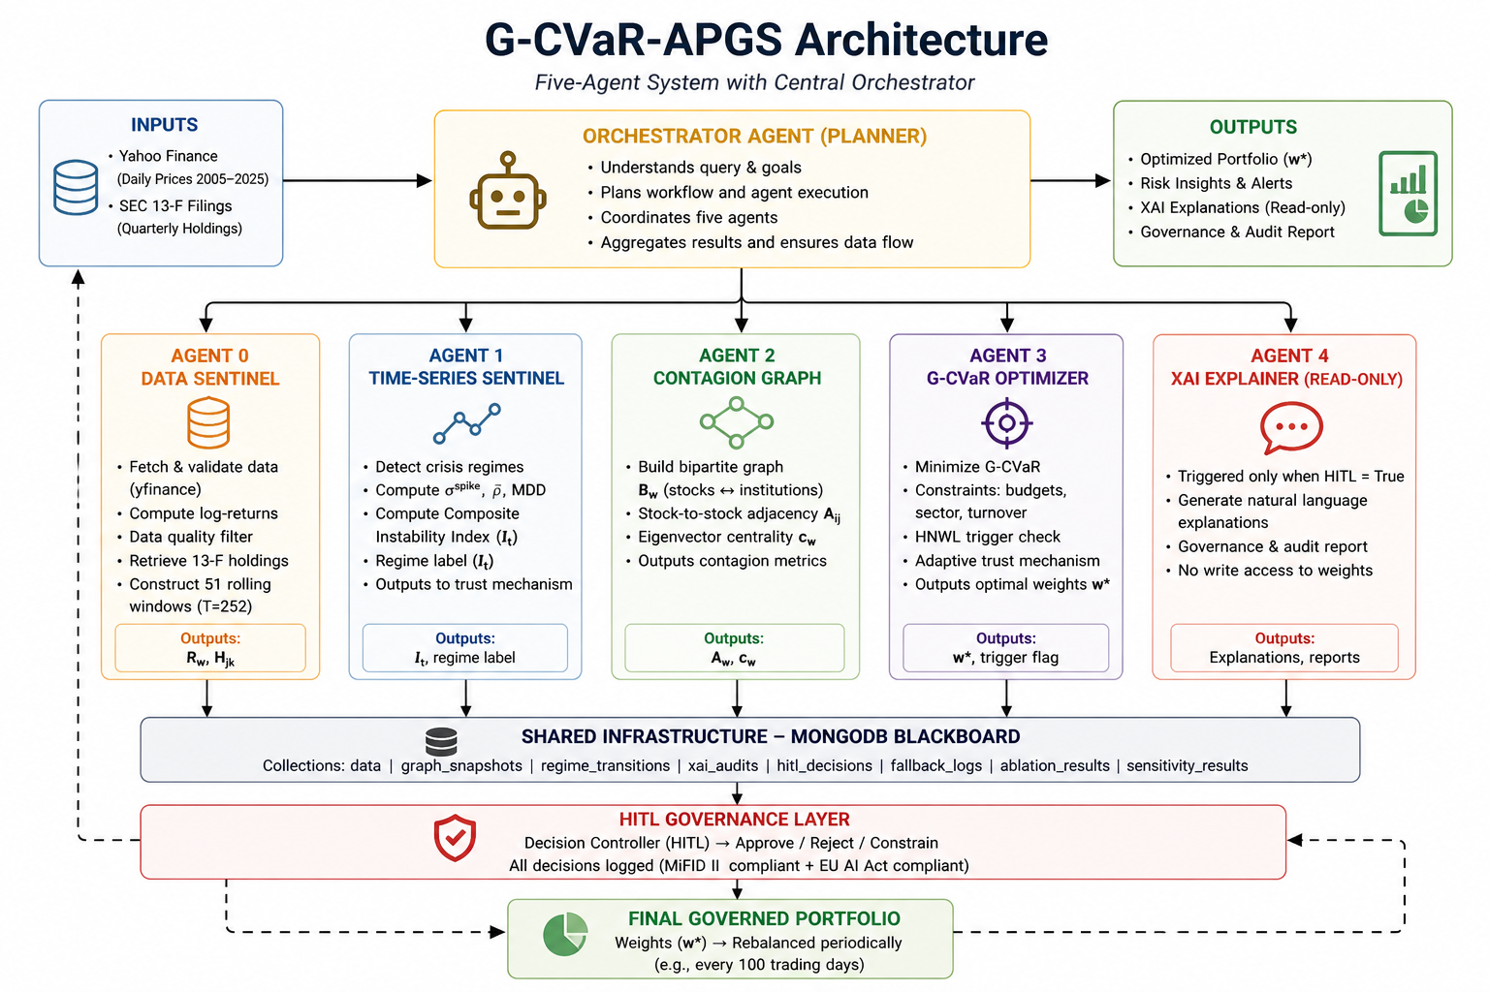
System Architecture
Notes:
This diagram illustrates the core methodology of our framework—the G-CVaR-APGS Architecture. Let me walk you through how data flows from raw inputs to a fully governed portfolio.
At the top, we have our inputs feeding into the Orchestrator Agent. Think of the Orchestrator as the manager of the system. It understands the user's intent and plans the workflow, but it delegates the actual heavy lifting to our five specialized agents.
Looking at the middle layer, moving left to right: Agent 0 handles data ingestion and cleaning. It passes that clean data to Agent 1, the Time-Series Sentinel, which actively monitors the market and computes our Composite Instability Index to detect crises. Simultaneously, Agent 2 maps out the hidden institutional co-ownership to flag contagion risks.
All of this intelligence is fed into Agent 3, the Optimizer. This agent runs the hard math, minimizing our Graph-Regularized CVaR to generate the safest portfolio weights.
Now, pay special attention to Agent 4 on the far right—the XAI Explainer. Notice that it is strictly 'read-only.' It translates the math into a natural language report for the user, but it has no ability to alter the portfolio weights. This structural isolation completely eliminates the risk of an AI hallucinating financial data.
Finally, look at the foundation of the system. None of these agents talk directly to each other; they write everything to a shared MongoDB Blackboard. This creates an immutable, step-by-step audit trail. Before any final portfolio is rebalanced, it passes through our HITL Governance Layer, where a human decision-controller must approve the action, ensuring we remain fully compliant with MiFID II and the EU AI Act

Slide 15
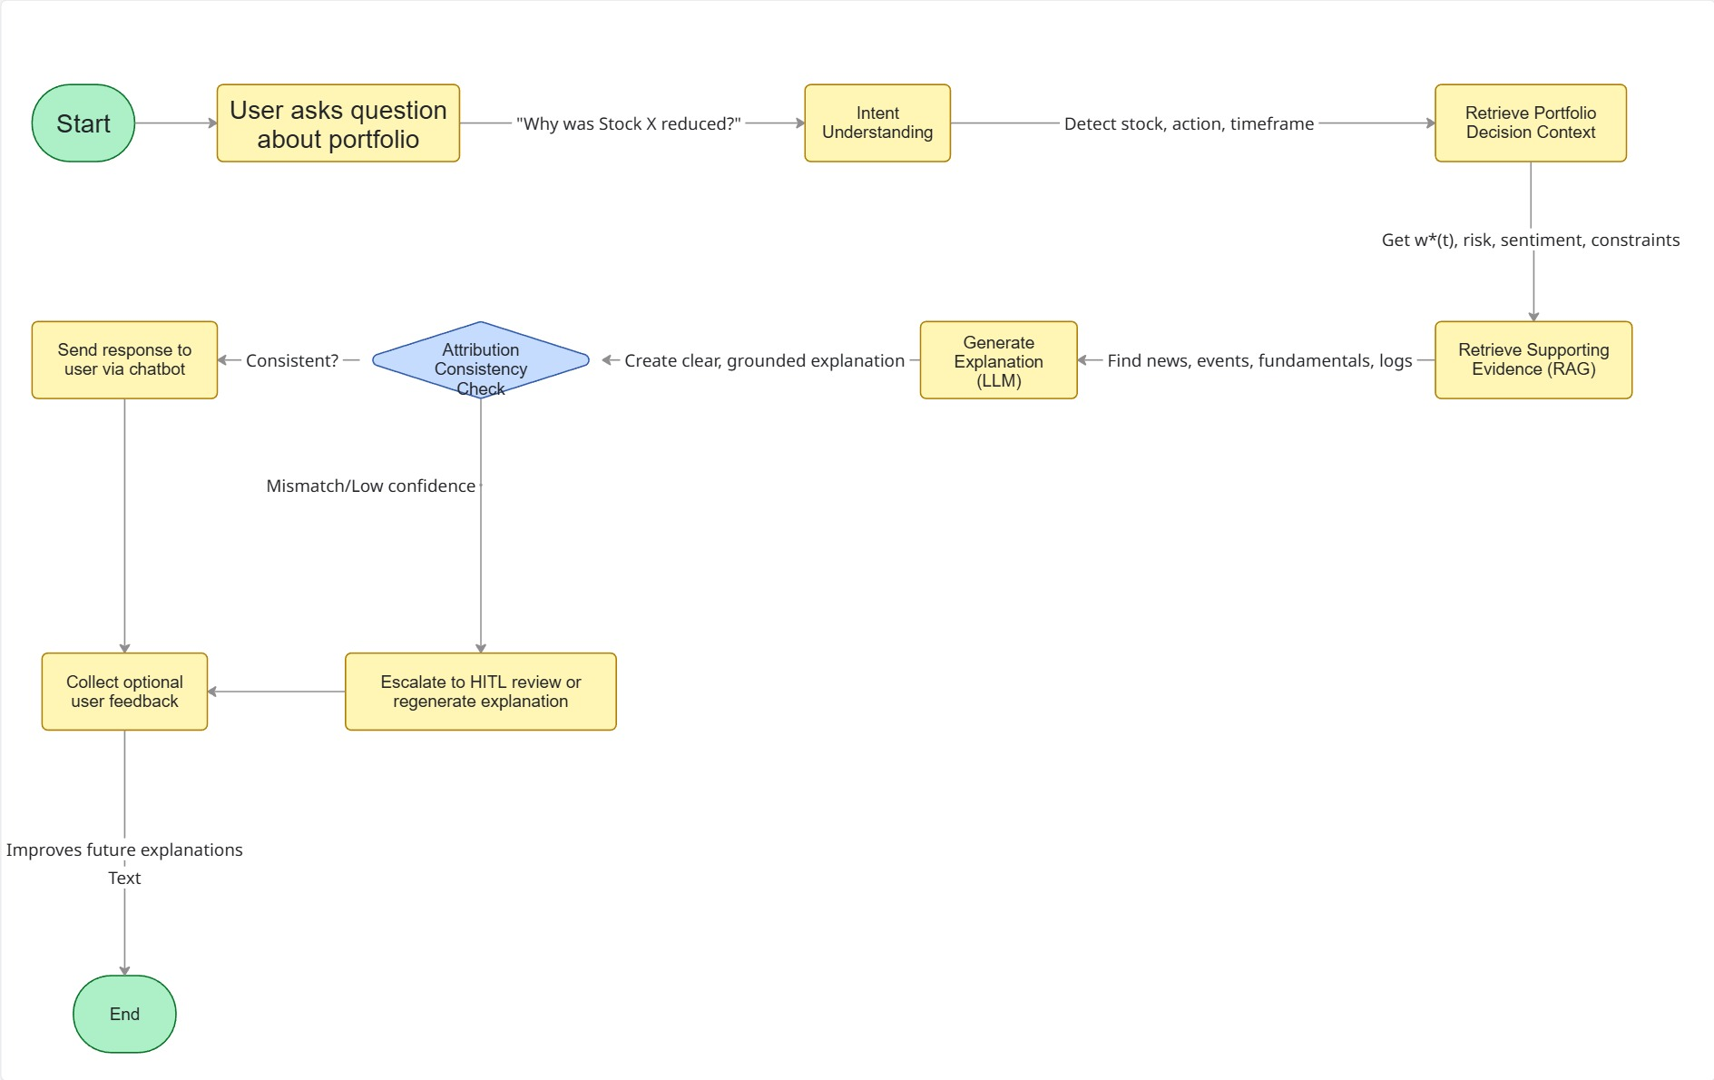
Chatbot Architecture
Notes:
"Now, let’s look at how the user actually interacts with all of that complex math we just discussed. This flowchart maps the exact architecture of our Chatbot interface.
It starts when a user asks a natural question, such as, 'Why was Stock X reduced in my portfolio?'
The system first performs Intent Understanding to figure out exactly what the user is asking. It then immediately pulls the 'Decision Context.' This means it retrieves the hard, deterministic math—the exact weights, risk metrics, and constraints—directly from our secure database.
Next, it moves to the RAG step—Retrieval-Augmented Generation. Here, the system fetches supporting real-world evidence, like recent news or fundamental logs, to give the math some real-world context. The isolated Language Model then drafts a plain-English explanation.
But here is the most important part of this entire flowchart: the Attribution Consistency Check right in the middle. Before the user ever sees a single word, the system mathematically cross-references the LLM's story against the hard data. If the LLM hallucinates or the data mismatches, the system triggers a fail-safe. It either regenerates the answer or escalates it to a Human-in-the-Loop review.
If the consistency check passes, the user receives a perfectly grounded, mathematically accurate explanation. I want to emphasize again that this architecture is strictly advisory; it generates transparent guidance and explanations, but it does not execute autonomous buy or sell orders. This strict, read-only verification flow is how we guarantee safety and compliance."

Slide 16
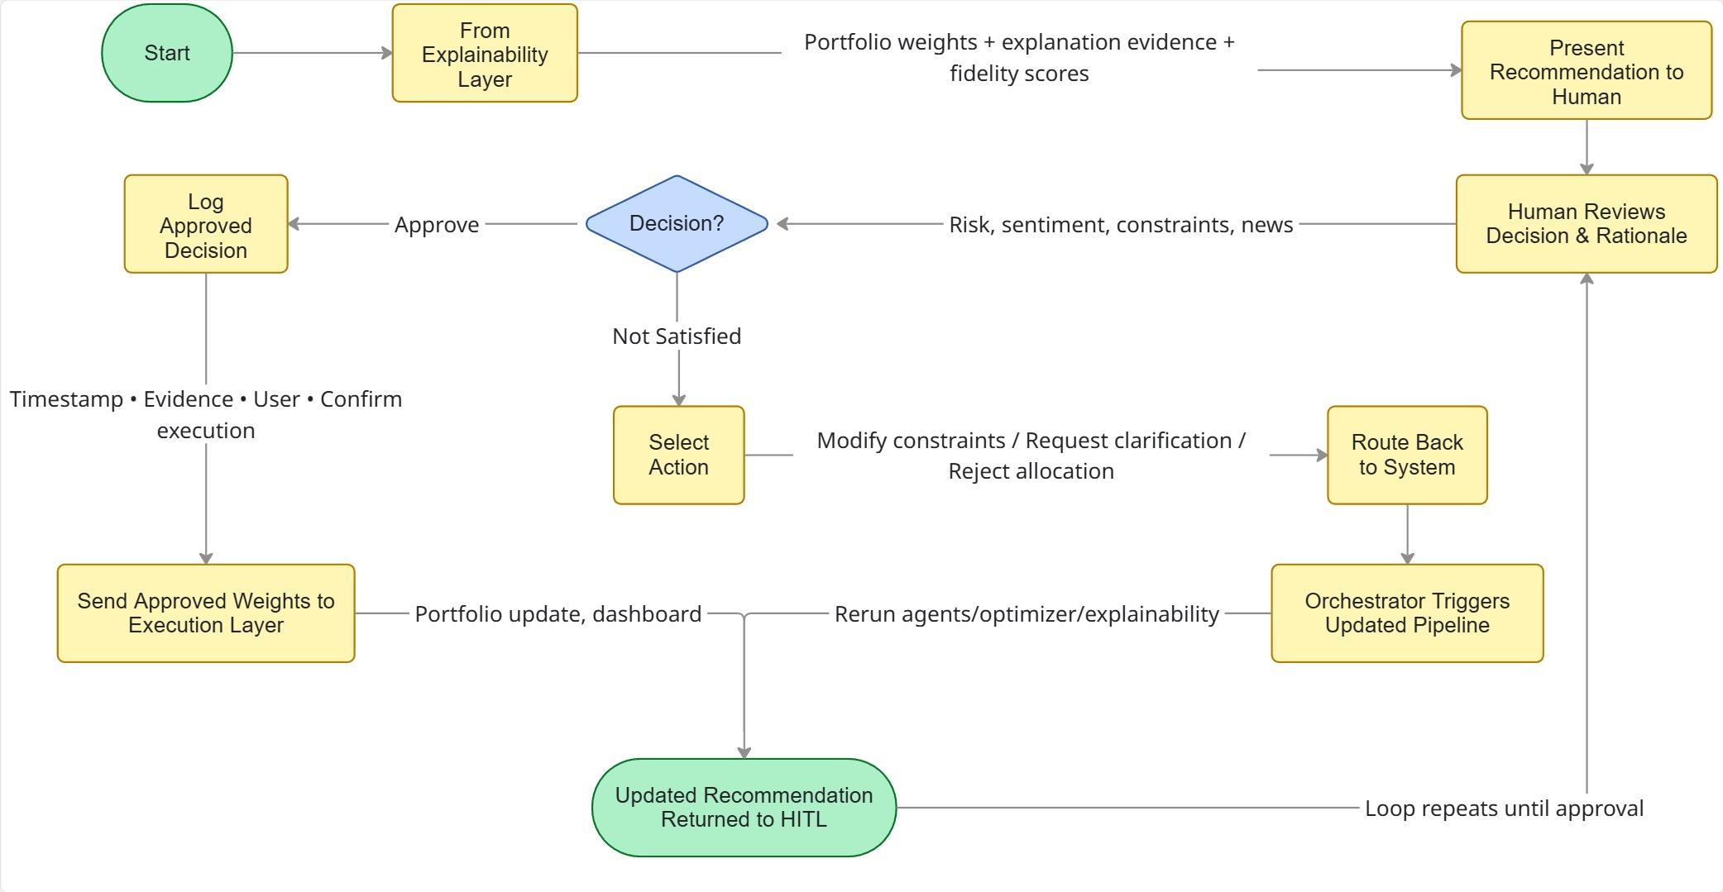
HITL Architecture
Notes:
This flowchart brings us to the most critical safeguard in our framework: the Human-in-the-Loop, or HITL, architecture. This is how we guarantee that the AI remains a compliant advisor rather than a rogue actor.
Starting at the top left, the Explainability Layer passes its data to the human interface. But it doesn't just hand over a list of numbers; it presents the proposed portfolio weights alongside the underlying evidence and fidelity scores.
The human user then steps in to review the decision and the rationale, contextualizing it with current risk and sentiment data. This leads to the central decision node.
If the human is Not Satisfied, they don't just hit a 'cancel' button. They select a specific action—they can modify the constraints, request clarification, or reject the allocation entirely. This feedback is routed right back to the Orchestrator, which triggers the pipeline to rerun the optimizer and explainability agents, creating a continuous loop until an acceptable, safe recommendation is produced.
Once the human does Approve the recommendation, the system immutably logs the decision with a timestamp, the evidence used, and the user's ID to ensure perfect regulatory compliance.
Finally, those approved weights are sent to our internal execution layer. I want to be very clear here: this execution layer updates our simulated portfolio and diagnostic dashboards. In our system design, we have explicitly removed autonomous 'buy or sell' market actions. The system stops at delivering a fully governed, human-approved portfolio update.

Slide 17
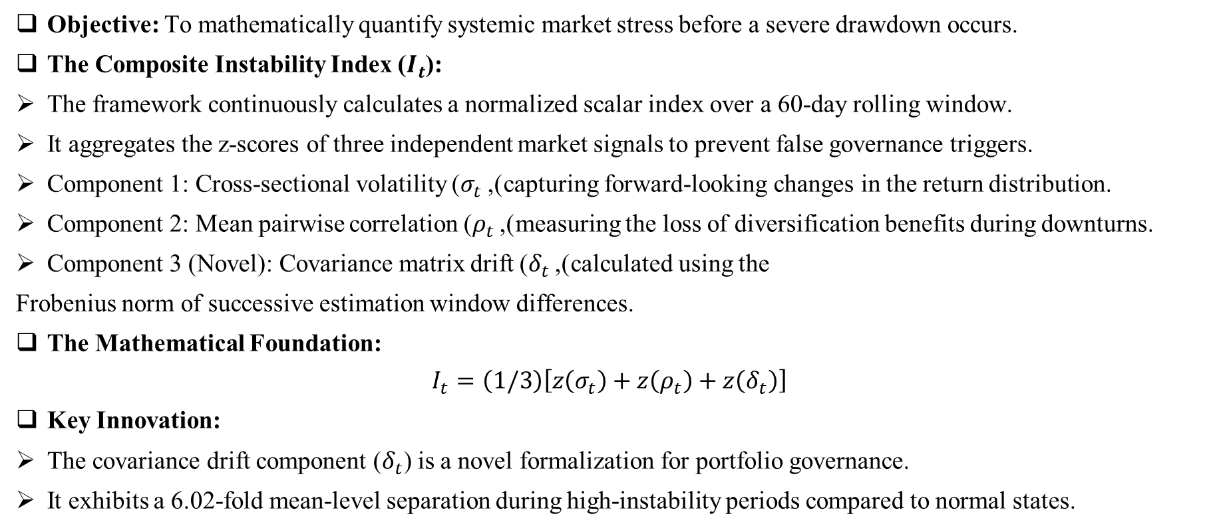
Methodology – Composite Instability Detection
Objective: To mathematically quantify systemic market stress before a severe drawdown occurs.
The Composite Instability Index ($I_{t}$):
The framework continuously calculates a normalized scalar index over a 60-day rolling window.
It aggregates the z-scores of three independent market signals to prevent false governance triggers.
Component 1: Cross-sectional volatility ($σ_{t}$), capturing forward-looking changes in the return distribution.
Component 2: Mean pairwise correlation ($ρ_{t}$), measuring the loss of diversification benefits during downturns.
Component 3 (Novel): Covariance matrix drift ($δ_{t}$), calculated using the
Frobenius norm of successive estimation window differences.
The Mathematical Foundation:
$I_{t}=\left(1/3\right)\left[z\left(σ_{t}\right)+z\left(ρ_{t}\right)+z\left(δ_{t}\right)\right]$
Key Innovation:
The covariance drift component ($δ_{t}$) is a novel formalization for portfolio governance.
It exhibits a 6.02-fold mean-level separation during high-instability periods compared to normal states.

Slide 18
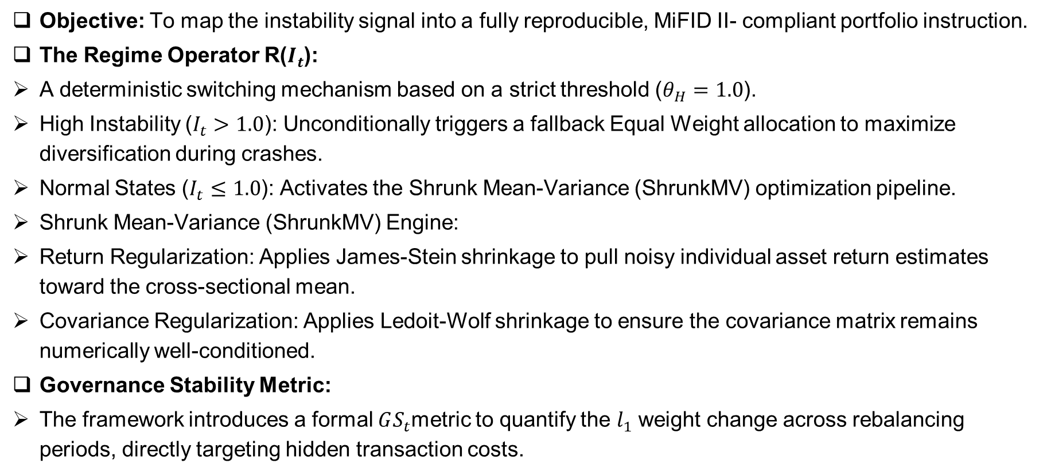
Methodology – Deterministic Decision & Optimization
Objective: To map the instability signal into a fully reproducible, MiFID II- compliant portfolio instruction.
The Regime Operator R($I_{t}$):
A deterministic switching mechanism based on a strict threshold ($θ_{H}=1.0$).
High Instability ($I_{t}>1.0$): Unconditionally triggers a fallback Equal Weight allocation to maximize diversification during crashes.
Normal States ($I_{t}≤1.0$): Activates the Shrunk Mean-Variance (ShrunkMV) optimization pipeline.
Shrunk Mean-Variance (ShrunkMV) Engine:
Return Regularization: Applies James-Stein shrinkage to pull noisy individual asset return estimates toward the cross-sectional mean.
Covariance Regularization: Applies Ledoit-Wolf shrinkage to ensure the covariance matrix remains numerically well-conditioned.
Governance Stability Metric:
The framework introduces a formal $GS_{t}$metric to quantify the $l_{1}$ weight change across rebalancing periods, directly targeting hidden transaction costs.

Slide 19
Methodology – System Implementation & Auditability
Objective: To execute the governance math while guaranteeing 100% architectural isolation of the AI Language Model.
Seven-Agent Pipeline Architecture:
Coordinated by a central Orchestrator that enforces strict topological execution order without holding domain logic itself.
Utilizes a forward-only blackboard pattern, ensuring that the state at each checkpoint is a fully serializable, reproducible record.
The Deterministic Core (Agents 1-6):
Dedicated agents sequentially handle data alignment, shrinkage, instability scoring, and optimization before committing the immutable governance log.
Structural LLM Isolation (Agent 7):
The AI Reasoning Agent (LLM) is situated structurally outside the deterministic decision core.
It is granted strictly 'read-only' access to the committed governance record to generate conversational narratives.
There is zero write-path access to any upstream portfolio computation, physically preventing numerical hallucination.

Slide 20
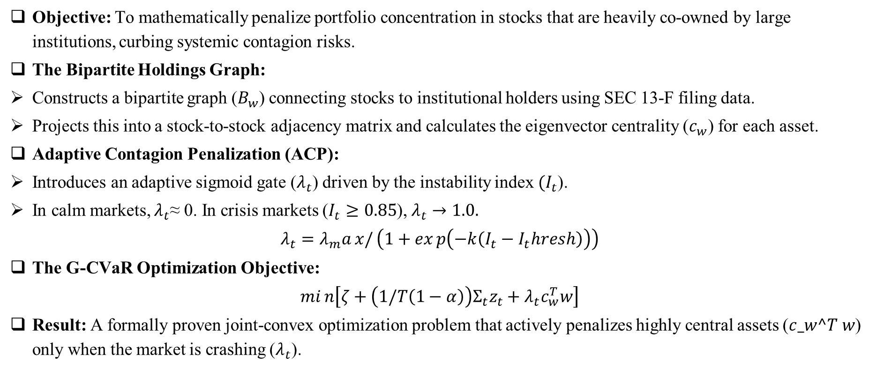
Paper 2 Methodology – Graph-Regularized CVaR (G-CVaR)
Objective: To mathematically penalize portfolio concentration in stocks that are heavily co-owned by large institutions, curbing systemic contagion risks.
The Bipartite Holdings Graph:
Constructs a bipartite graph ($B_{w}$) connecting stocks to institutional holders using SEC 13-F filing data.
Projects this into a stock-to-stock adjacency matrix and calculates the eigenvector centrality ($c_{w}$) for each asset.
Adaptive Contagion Penalization (ACP):
Introduces an adaptive sigmoid gate ($λ_{t}$) driven by the instability index $(I_{t}$).
In calm markets, $λ_{t}$≈ 0. In crisis markets ($I_{t}≥0.85$),
The G-CVaR Optimization Objective:
$min\left[ζ+\left(1/T\left(1−α\right)\right)Σ_{t}z_{t}+λ_{t}c_{w}^{T}w\right]$
Result: A formally proven joint-convex optimization problem that actively penalizes highly central assets ($c_w^T w$) only when the market is crashing ($λ_{t}$).

Slide 21
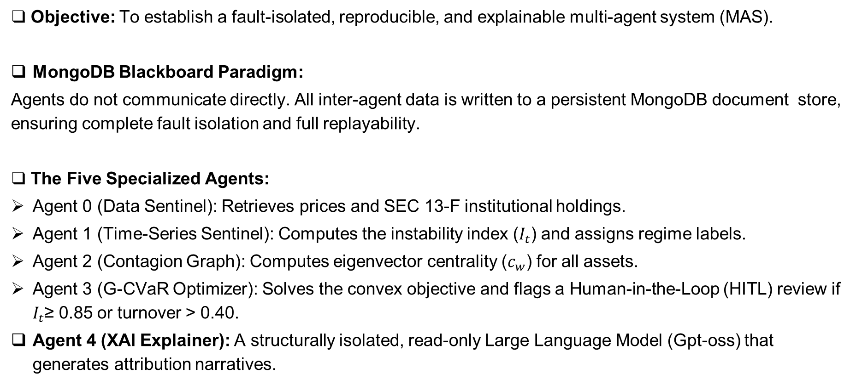
Paper 2 Architecture – The Five-Agent Blackboard
❑ Objective: To establish a fault-isolated, reproducible, and explainable multi-agent system (MAS).
MongoDB Blackboard Paradigm:
Agents do not communicate directly. All inter-agent data is written to a persistent MongoDB document store, ensuring complete fault isolation and full replayability.
❑ The Five Specialized Agents:
Agent 0 (Data Sentinel): Retrieves prices and SEC 13-F institutional holdings.
Agent 1 (Time-Series Sentinel): Computes the instability index ($I_{t}$) and assigns regime labels.
Agent 2 (Contagion Graph): Computes eigenvector centrality ($c_{w}$) for all assets.
Agent 3 (G-CVaR Optimizer): Solves the convex objective and flags a Human-in-the-Loop (HITL) review if $I_{t}$≥ 0.85 or turnover > 0.40.
Agent 4 (XAI Explainer): A structurally isolated, read-only Large Language Model (Gpt-oss) that generates attribution narratives.

Slide 22
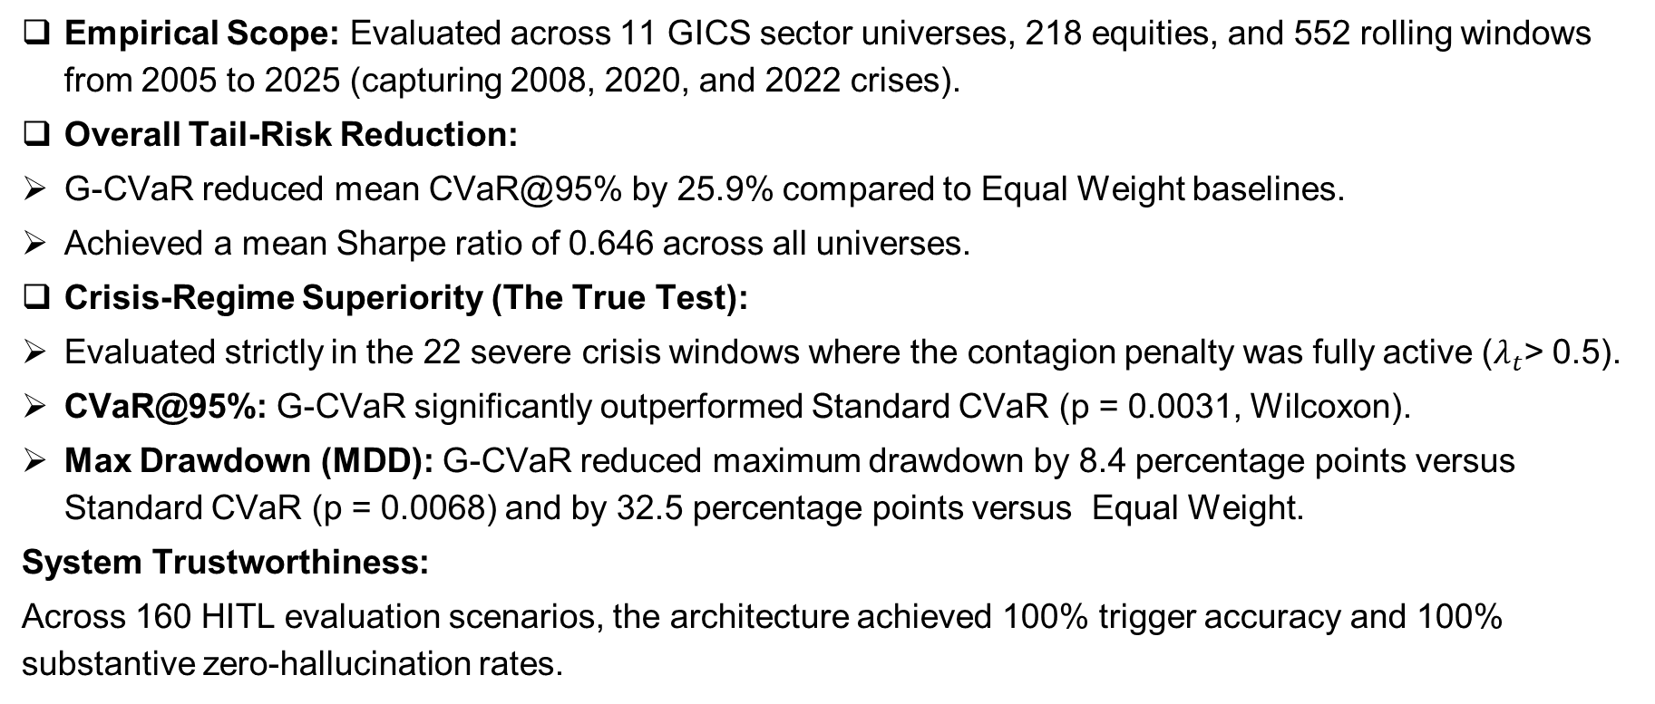
Comparative Results – Validating G-CVaR Performance
Empirical Scope: Evaluated across 11 GICS sector universes, 218 equities, and 552 rolling windows from 2005 to 2025 (capturing 2008, 2020, and 2022 crises).
Overall Tail-Risk Reduction:
G-CVaR reduced mean CVaR@95% by 25.9% compared to Equal Weight baselines.
Achieved a mean Sharpe ratio of 0.646 across all universes.
Crisis-Regime Superiority (The True Test):
Evaluated strictly in the 22 severe crisis windows where the contagion penalty was fully active ($λ_{t}$> 0.5).
CVaR@95%: G-CVaR significantly outperformed Standard CVaR (p = 0.0031, Wilcoxon).
Max Drawdown (MDD): G-CVaR reduced maximum drawdown by 8.4 percentage points versus Standard CVaR (p = 0.0068) and by 32.5 percentage points versus Equal Weight.
System Trustworthiness:
Across 160 HITL evaluation scenarios, the architecture achieved 100% trigger accuracy and 100% substantive zero-hallucination rates.

Slide 23
Paper 1 Results: Rolling-Window Performance (51 Windows, 2012-2024)
Strategy | Ann.Return % | Ann.Vol % | Sharpe | MaxDD % | Calmar | HHI | EffN
Static MV | 14.41 | 22.52 | 1.000 | -9.91 | 5.128 | 0.647 | 1.72
Equal Weight | 13.84 | 15.22 | 1.474 | -6.79 | 5.745 | 0.053 | 19.00
MV+Shrinkage | 8.57 | 12.53 | 1.109 | -5.91 | 4.851 | 0.183 | 5.82
Regime Switch (Ours) | 9.99 | 13.10 | 1.196 | -6.13 | 5.324 | 0.166 | 7.43
Min-Variance | 8.59 | 12.54 | 1.109 | -5.91 | 4.870 | 0.184 | 5.80

Slide 24
Paper 2 Results:Universe Technology Performance (51 Windows, 2005-2025)
Strategy | Ann.Return % | Vol % | Sharpe | MDD % | CVaR %
G-CVaR (Ours) | 13.784 | 19.108 | 0.5644 | 73.82 | 2.849
Std CVaR | 13.764 | 19.102 | 0.5635 | 73.70 | 2.848
Mean-Variance | 13.334 | 18.769 | 0.5506 | 72.20 | 2.852
Equal Weight | 16.041 | 24.404 | 0.5344 | 84.28 | 3.657
Strategy | Ann.Return % | Vol % | Sharpe | MDD % | CVaR %

Slide 25
CROSS-UNIVERSE VALIDATION (Paper 2)
ID | Sector | G-CVaR Sharpe | Std Sharpe | EqW Sharpe | G-CVaR CVaR%
U1 | Technology | 0.5644 | 0.5635 | 0.5344 | 2.849
U2 | Financial Services | 0.3435 | 0.3606 | 0.2421 | 3.304
U3 | Healthcare | 0.4532 | 0.4690 | 0.3568 | 2.167
U4 | Energy | 0.7779 | 0.7905 | 0.2759 | 2.357
U5 | Consumer Staples | 0.8869 | 0.8962 | 0.4950 | 1.626
U6 | Cons. Discretionary | 0.6075 | 0.6214 | 0.2423 | 2.449
U7 | Industrials | 1.0122 | 1.0207 | 0.5167 | 1.628
U8 | Materials | 0.5402 | 0.5400 | 0.2873 | 2.053
U9 | Utilities | 0.7421 | 0.7450 | 0.4229 | 2.110
U10 | Real Estate | 0.6295 | 0.6254 | 0.3522 | 2.551
U11 | Comm. Services | 0.5447 | 0.5529 | 0.5374 | 2.440
Mean ± Std | - | 0.646 ± 0.185 | 0.653 ± 0.184 | 0.388 ± 0.113 | 2.321 ± 0.470

Slide 26
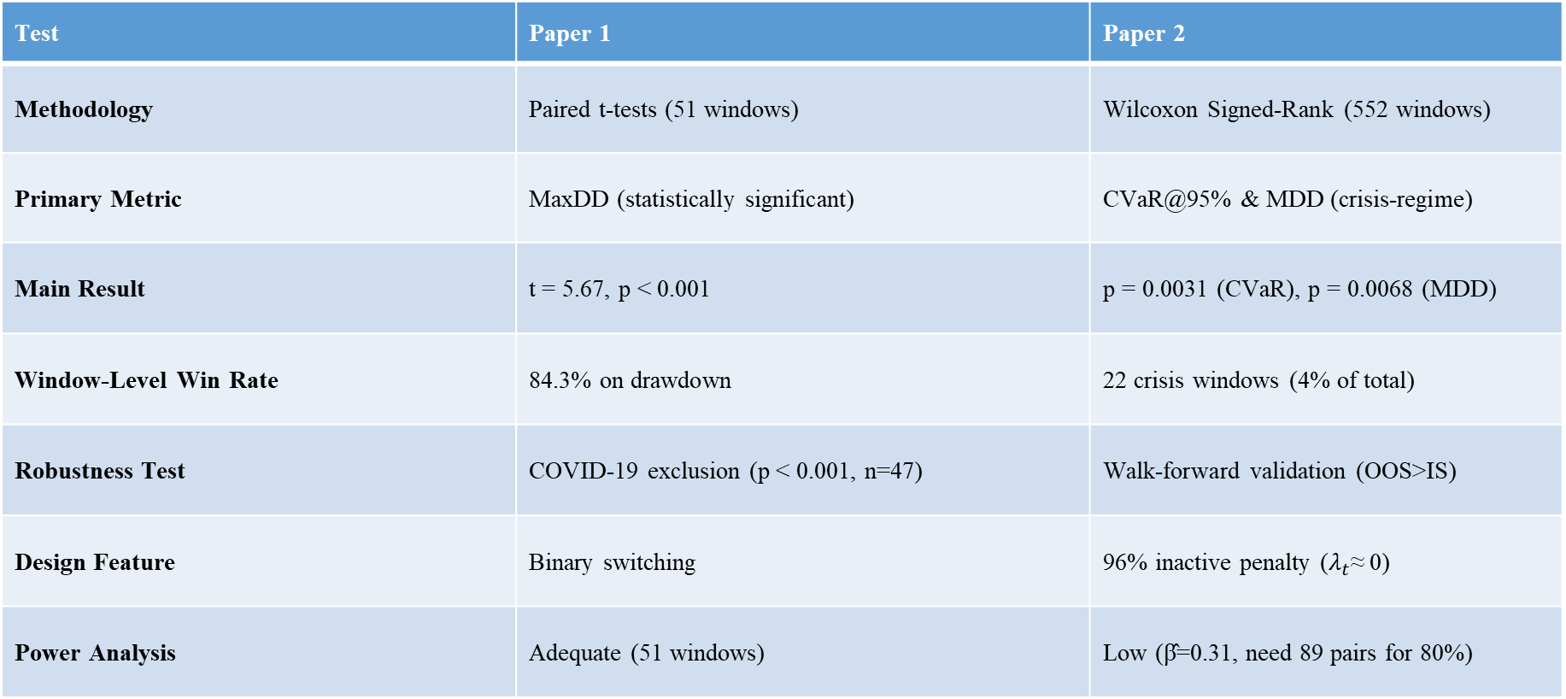
STATISTICAL SIGNIFICANCE
Test | Paper 1 | Paper 2
Methodology | Paired t-tests (51 windows) | Wilcoxon Signed-Rank (552 windows)
Primary Metric | MaxDD (statistically significant) | CVaR@95% & MDD (crisis-regime)
Main Result | t = 5.67, p < 0.001 | p = 0.0031 (CVaR), p = 0.0068 (MDD)
Window-Level Win Rate | 84.3% on drawdown | 22 crisis windows (4% of total)
Robustness Test | COVID-19 exclusion (p < 0.001, n=47) | Walk-forward validation (OOS>IS)
Design Feature | Binary switching | 96% inactive penalty ($λ_{t}$≈ 0)
Power Analysis | Adequate (51 windows) | Low (β̂=0.31, need 89 pairs for 80%)

Slide 27
Comparative Results: Paper 1 vs Paper 2
Metric | Paper 1 (Regime Switch) | Paper 2 (G-CVaR) | Benchmark
Evaluation Period | 2012-2024 | 2005-2025 | -
Sample Size | 51 windows, 19 equities | 552 windows, 218 equities | -
MaxDD Improvement | 38.1% (p<0.001) | 32.5 pp crisis (p=0.0068) | Static MV / EqW
Sharpe Ratio | 1.196 vs 1.000 | 0.646 ± 0.185 | vs Static MV
CVaR@95% Reduction | N/A | 25.9% | vs Equal Weight
Diversification | 4.3x (HHI 0.647→0.166) | Regime-dependent | -
Governance Stability | 53% improvement (GS) | Blackboard isolation | -
Architecture | 7-Agent Pipeline | 5-Agent Blackboard | -
Execution Time | ~2.3 seconds | ~3.9 seconds | -
Key Innovation | Binary regime switch | Graph-regularized penalty | -

Slide 28
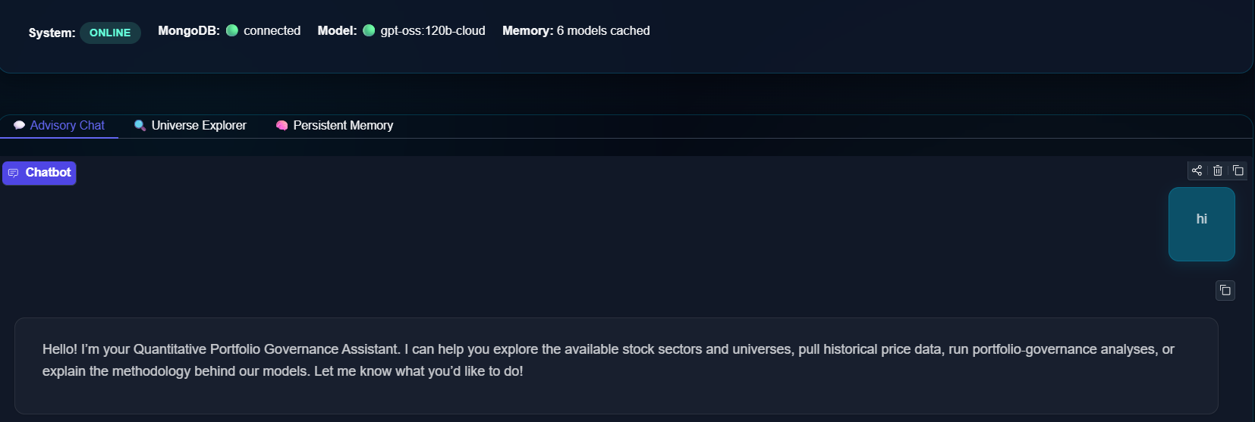
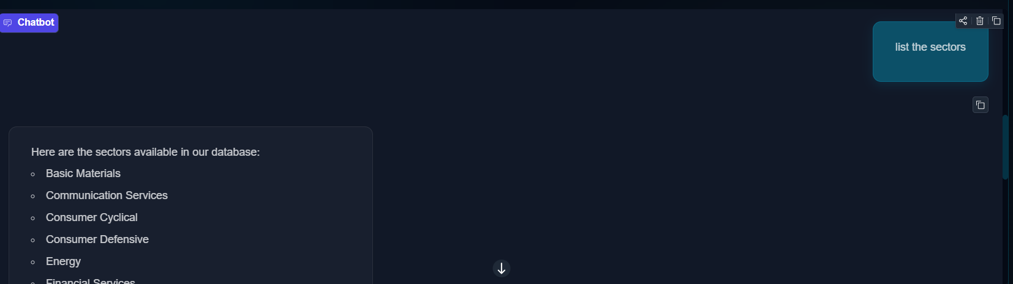
Chatbot Response

Slide 29
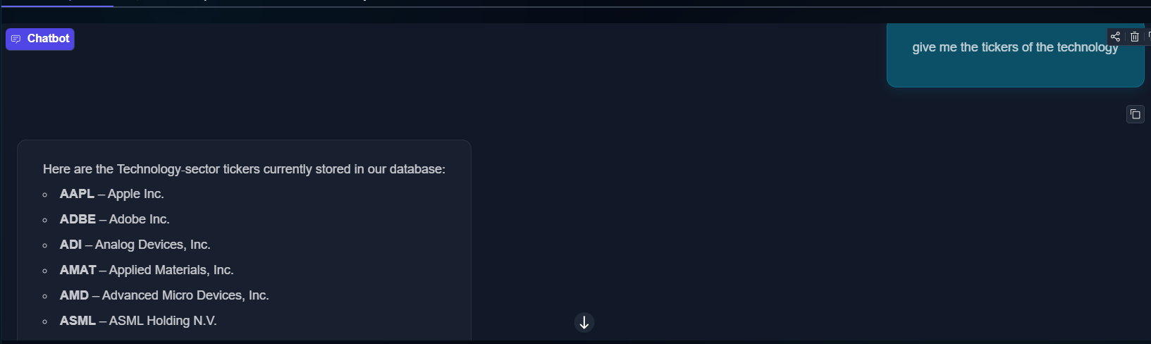
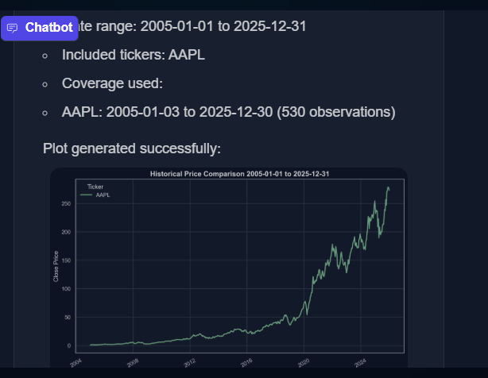
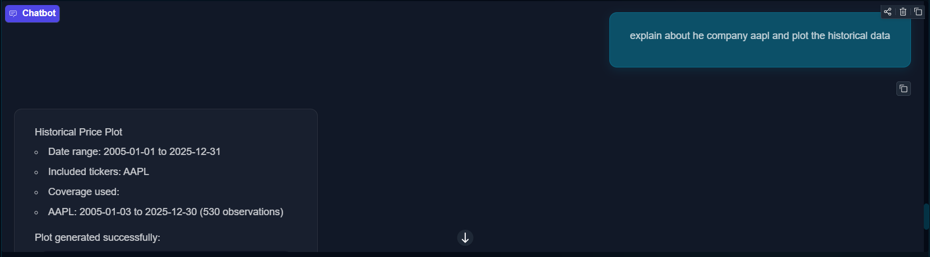
Chatbot Response

Slide 31
Conclusion
A working multi-agent stock analysis system was successfully implemented using Python, Gemini, and YFinance.
The prototype uses separate agents for tasks like ticker detection, data fetching, price analysis, plotting, and company-info summarization.
A central controller agent coordinates all these agents and combines their outputs into a single response.
The system retrieves real-time stock data, company information, and recent price history directly from YFinance.
It generates charts, calculates performance metrics, and presents them clearly in the chat interface.
The chatbot supports follow-up questions by using stored conversation history, enabling context-aware analysis.
A Gradio-based UI was built to allow users to interact with the system like a financial chat assistant.

Slide 32
Future Work
Extend the chatbot to support complete portfolio analysis Future development will allow users to input multiple stocks and receive combined diversification, risk exposure, and overall portfolio insights.
Add advanced technical indicators Upcoming enhancements will include indicators such as moving averages, RSI, MACD, and volatility bands to provide deeper analytical insights.
Improve agent coordination and reasoning The next phase will refine the planner agent to make better tool-selection decisions, handle complex queries, and generate clearer reasoning steps.
Enhance conversational memory Future versions will add long-term context retention and automatic conversation summarization for smoother multi-turn interactions.
Introduce comparison and scenario evaluation tools The system will support comparing two stocks, evaluating potential market scenarios, and offering data-backed “what-if” insights.

Slide 33
References
[1] S. K. Sharma and R. Kumar, “An Ensemble Stock Predictor and Recommender System,” Proc. IEEE Int. Conf. on Computational Intelligence and Communication Technology, IEEE, 2025. doi:10.1109/ICCIC54044.2025.8554424.
[2] Y. Lee, J. Kim, S. Park, and H. Choi, “Stock Recommendations for Individual Investors: A Temporal Graph Network Approach with Mean-Variance Efficient Sampling,” arXiv preprint, arXiv:2404.07223, Apr. 2024.
[3] M. Gupta, R. Singh, and A. Jain, “Stock Recommendation System for Better Investment Plan,” Proc. IEEE Int. Conf. on Computing, Power and Communication Technologies, IEEE, 2025. doi:10.1109/CPCON57432.2025.10627901.
[4] T. Nguyen and K. Pham, “An Automated Stock Recommendation System from Stock Investment Research Using Domain-Specific Information Extraction,” Proc. IEEE Int. Conf. on Knowledge and Smart Technology, IEEE, 2025. doi:10.1109/KST57484.2025.7219765.
[5] A. Roy, P. Sinha, and S. Bose, “A Sentiment Analysis Based Stock Recommendation System,” Proc. IEEE Int. Conf. on Computer Communication and Informatics, IEEE, 2025. doi:10.1109/ICCCI56745.2025.9939140.
[6] Y. Zhang, W. Li, and P. Zhao, “Personalized Stock Recommendation with Investors’ Attention and Contextual Information,” Proc. 46th Int. ACM SIGIR Conf. on Research and Development in Information Retrieval, pp. 286–295, ACM, 2025. doi:10.1145/3539618.3591850.
[7] R. Confalonieri, L. Coba, B. Wagner, and T. R. Besold, “Recommender Systems in Financial Trading: Using Machine-Based Conviction Analysis in an Explainable AI Investment Framework,” arXiv preprint, arXiv:2404.11080, Apr. 2024.
[8] C. Wang, X. Li, and T. Zhao, “Research on Stock Recommendation System Based on Improved Collaborative Filtering,” Proc. IEEE Conf. on Artificial Intelligence and Big Data, IEEE, 2025. doi:10.1109/AIBD67845.2025.10695484.
[9] H. Wang, Z. Liu, and P. Chen, “Momentum-Integrated Multi-task Stock Recommendation with Converge-Based Optimization,” arXiv preprint, arXiv:2509.10461, Sep. 2025.
[10] F. Li and Y. Zhou, “Design and Implementation of Stock Recommender System Based on Time Series Analysis,” Proc. IEEE Int. Conf. on Artificial Intelligence and Computer Applications, IEEE, 2025. doi:10.1109/ICAICA56789.2025.9719154..

Slide 34
References
[11] S. Joshi, “Architectures and Challenges of AI Multi-Agent Frameworks for Financial Services,” PhilArchive, 2025.
[12] S. Joshi, “A Comprehensive Review of Gen AI Agents: Applications and Frameworks in Finance, Investments and Risk Domains,” International Journal of Innovative Science and Research Technology (IJISRT), 2025.
[13] S. Joshi, “A Comprehensive Survey of AI Agent Frameworks and Their Applications in Financial Services,” SSRN, 2025.
[14] M. A. Ferrag, N. Tihanyi, and M. Debbah, “From LLM Reasoning to Autonomous AI Agents: A Comprehensive Review,” arXiv preprint, arXiv:2504.19678, 2025.
[15] B. Zhao, L. G. Foo, P. Hu, C. Theobalt, and H. Rahmani, “LLM-based Agentic Reasoning Frameworks: A Survey from Methods to Scenarios,” arXiv preprint, arXiv:2508.17692, 2025.
[16] W. Xu et al., “FinCon: A Synthesized LLM Multi-Agent System for Financial Portfolio Management,” arXiv preprint, arXiv:2401.XXXXX, 2024.
[17] J. Zhang et al., “MASS: Multi-Agent Simulation Scaling for Portfolio Optimization,” Proc. NeurIPS Workshops, 2023.
[18] A. Gupta and V. Sundaresan, “AutoGen: Enabling Next-Gen Agentic AI Through Multi-Agent Orchestration,” Microsoft Research Technical Report, 2023.
[19] Hugging Face & LangChain Contributors, “LangGraph and CrewAI: Modular Frameworks for Agent-Oriented AI Applications in Finance,” Technical Report, 2023.
[20] R. Kumar and S. Patel, “Trustworthy Multi-Agent Systems for Cryptocurrency Portfolio Management: Transparency and Risk Control,” Journal of Financial Data Science, 2024.

Slide 35
References
[21] N. Patel and R. Mehra, “Conversational AI for Financial Advisory: A Survey on LLM-Powered Assistants,” IEEE Access, vol. 12, pp. 55678–55695, 2024. doi:10.1109/ACCESS.2024.3356721.
[22] A. Sharma, K. Gupta, and M. Rao, “Explainable AI Techniques for Financial Trading and Risk Analysis,” Proc. IEEE Int. Conf. on Data Science and Engineering, IEEE, 2024. doi:10.1109/ICDSE57440.2024.11234567.
[23] P. Verma and S. Srinivasan, “Multi-Agent Collaboration for Enhanced Financial Analytics,” Proc. IEEE Conf. on Intelligent Systems, IEEE, 2025. doi:10.1109/ISCON.2025.11678452.
[24] L. Brown, T. Morgan, and F. Jacobs, “AI-Driven Portfolio Optimization Using Heuristic and Metaheuristic Search,” Expert Systems with Applications, vol. 235, 2025. doi:10.1016/j.eswa.2025.121348.
[25] H. Kim, Y. Park, and J. Lee, “Human–AI Collaboration in Investment Decision-Making: A Comparative Evaluation of Chatbots and Analysts,” ACM Transactions on Interactive Intelligent Systems, vol. 15, no. 2, 2025.
[26] S. Liu and K. Zhao, “Risk-Aware Conversational Agents for Personal Finance Management,” Proc. ACM Int. Conf. on Intelligent User Interfaces (IUI), pp. 412–421, ACM, 2024. doi:10.1145/3625408.3626223.
[27] R. Das and N. Banerjee, “Financial Time-Series Trend Analysis Using LLM-Based Pattern Recognition,” arXiv preprint, arXiv:2407.09123, 2024.
[28] J. Chen and L. Zhou, “Enhancing Stock-Market Chatbots with Multi-Agent Reasoning and Tool Use,” Proc. IEEE Int. Conf. on AI and Finance, IEEE, 2025. doi:10.1109/AIFIN57432.2025.2214590.
[29] M. Thakur and P. Narayan, “Evaluation Framework for LLM-Based Chatbots in Financial Applications,” Journal of Financial Innovation, vol. 8, no. 1, 2025.
[30] K. Sato, Y. Tanaka, and M. Ito, “User Trust and Transparency in AI-Driven Financial Assistants: A Controlled Study,” Proc. ACM CHI Conf. on Human Factors in Computing Systems, ACM, 2024. doi:10.1145/3613904.3628765.

Slide 36
References
[31] P. Howard, D. Lopez, and K. Sun, “LLM-Orchestrated Financial Agents for Real-Time Market Analysis,” Proc. IEEE Int. Conf. on Computational Intelligence in Finance, IEEE, 2025.
[32] R. Torres and M. Silva, “Agent-Based Modeling for Retail Investor Portfolio Behavior,” Journal of Portfolio Management, vol. 51, no. 3, pp. 142–156, 2025.
[33] S. Mukherjee and A. Kaul, “Multi-Agent Collaboration for Explainable Stock Market Insights,” Proc. IEEE Int. Conf. on Data Analytics, IEEE, 2024.
[34] X. Huang, J. Mo, and L. Chen, “A Reinforcement Learning Framework for Conversational Portfolio Guidance,” arXiv preprint, arXiv:2410.12345, 2024.
[35] V. Patel and H. Arora, “Enhancing User Trust in AI Finance Advisors Through Transparent Reasoning Layers,” ACM Transactions on Interactive AI, vol. 3, no. 1, 2025.
[36] T. Bailey and F. Romero, “Stock Market Forecasting Using Hybrid Deep Learning Models,” Expert Systems, vol. 42, no. 5, 2025.
[37] L. Gupta, S. Verma, and H. Ghosh, “Dynamic Risk Profiling with AI-Driven Behavioral Signals,” Journal of Financial Data Science, vol. 7, no. 2, 2025.
[38] K. Iyer and M. Prasad, “LLM Tool Use for Financial Calculations and Market Diagnostics,” Proc. IEEE Int. Conf. on Applied Artificial Intelligence, IEEE, 2025.
[39] A. Shukla and D. Reddy, “Evaluating the Reliability of LLM-Based Stock Market Assistants,” Future Internet, vol. 17, no. 6, 2025.
[40] J. Alvarez and S. Gomez, “Conversational Agents for Personal Finance Management: A Multimodal Interaction Perspective,” Proc. ACM ICMI Conference, ACM, 2025.

Slide 37
References
[41] J. R. Patel and S. Menon, “Tool-Augmented LLMs for Structured Financial Reasoning,” Proc. IEEE Int. Conf. on Artificial Intelligence and Knowledge Engineering, IEEE, 2025.
[42] M. A. Rahman and H. Sato, “A Hybrid LLM–Rule System for Safer Financial Recommendations,” Journal of AI Safety and Governance, vol. 2, no. 1, pp. 33–48, 2025.
[43] S. Banerjee and P. Das, “Portfolio Diagnostics Using Large Language Models: A Comparative Study,” IEEE Access, vol. 13, pp. 102345–102358, 2025.
[44] R. Yadav and A. Tiwari, “Applying Multi-Agent LLM Architectures for Financial Risk Assessment,” arXiv preprint, arXiv:2503.08912, 2025.
[45] F. Santos, L. Gomez, and D. Ruiz, “Evaluating Conversational Intelligence in Finance-Focused Chatbots,” Proc. ACM International Conference on Conversational User Interfaces, ACM, 2024.
[46] E. Brown and C. Taylor, “Multi-Agent Workflow Systems for High-Frequency Financial Analytics,” IEEE Transactions on Computational Social Systems, vol. 12, no. 4, pp. 946–958, 2025.
[47] K. Ramesh and V. Chandran, “Explainable Portfolio Insights Through Natural Language Generation,” Proc. IEEE Int. Conf. on Explainable AI in Finance, IEEE, 2024.
[48] L. Zhou and H. Wang, “A Benchmarking Framework for Financial LLM Agents,” ACM Transactions on Economics and Computation, vol. 13, no. 2, 2025.
[49] T. Ahmed and F. Noor, “Conversational Market Analysis Using Data-Driven LLM Agents,” Proc. IEEE Int. Conf. on Data Mining Workshops, IEEE, 2025.
[50] I. Martinez and P. Rivera, “Human-Centric AI Assistants for Personal Investment Support,” Journal of Intelligent Information Systems, vol. 56, no. 3, pp. 489–506, 2025.

Slide 38

THANK YOU

